Slide 1
The BIG Soccer Aid for UNICEF Academy Quiz

Slide 2
There are a range of questions about UNICEF and Soccer Aid’s work.
Please determine which are appropriate for your class

Slide 3
What does the ‘C’
in UNICEF stand for?
Answer - Children

Slide 4
How many countries or territories is UNICEF present in?
“QUOTE OR PULL-OUT TEXT
IN FUSE V2 REGULAR.”
Answer – ‘c’ 190+
100
50
190+
89

Slide 5
When did Soccer Aid for UNICEF begin?
Answer - 2006

Slide 6
How much money has Soccer Aid raised for UNICEF?
“QUOTE OR PULL-OUT TEXT
IN FUSE V2 REGULAR.”
Answer – ‘d’
£10 million
£75 million
£43 million
£90 million

Slide 7

Which country that UNICEF works in does this flag belong to?
Answer - India

Slide 8
How many vaccine doses does UNICEF provide each year?
“QUOTE OR PULL-OUT TEXT
IN FUSE V2 REGULAR.”
Answer – ‘a’
Over 2 billion
3 million
1000
1.4 million

Slide 9
Which Soccer Aid side has won the most matches?
Answer – World XI

Slide 10


Name this Soccer Aid for UNICEF player
Answer – ‘d’
“QUOTE OR PULL-OUT TEXT
IN FUSE V2 REGULAR.”
Usain Bolt
Robbie Williams
David James
Mo Farah

Slide 11
Finish the Soccer Aid for UNICEF tagline
Play for every….
child

Slide 12
How many goals have been scored at Soccer Aid for UNICEF in total?
“QUOTE OR PULL-OUT TEXT
IN FUSE V2 REGULAR.”
Answer – ‘c’
67
102
53
78

Slide 13

Which country that UNICEF works in does this flag belong to?
Answer - Romania

Slide 14
How many red cards has there been ever in Soccer Aid for UNICEF?
1
5
9
0
“QUOTE OR PULL-OUT TEXT
IN FUSE V2 REGULAR.”
Answer – ‘a’

Slide 15

Can you name 3 people who are playing in this years Soccer Aid for UNICEF?
Notes:
More names might have been announced since the graphic was added

Slide 16
The price of a single dose of a polio vaccine is?
90p
10p
45p
£1
“QUOTE OR PULL-OUT TEXT
IN FUSE V2 REGULAR.”
Answer – ‘b’

Slide 17

Who was the first female captain at Soccer Aid for UNNCEF?
Answer – Jill Scott

Slide 18
Which football ground has hosted Soccer Aid for UNICEF the most times?
“QUOTE OR PULL-OUT TEXT
IN FUSE V2 REGULAR.”
Stamford Bridge, Chelsea
St James’s Park, Newcastle
Etiad, Manchester City
Old Trafford, Manchester United
Answer – ‘d’

Slide 19

Which country that UNICEF works in does this flag belong to?
Answer: Kenya

Slide 20
How many tickets in total has Soccer Aid for UNICEF sold, ever?
666,258
567,986
453,567
1,000,000
Answer – ‘a’

Slide 21
What year was UNICEF founded?
Answer- 1946

Slide 22
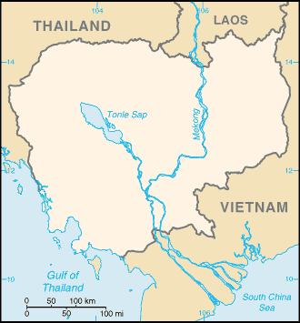
Which country that UNICEF works in is not labelled here?
Cambodia

Slide 23
Soccer Aid is the only official mixed gender sanctioned match by the FA
Answer – ‘a’
True
False

