Slide 1
SOCCER AID FOR UNICEF ACADEMY 2024

Slide 2
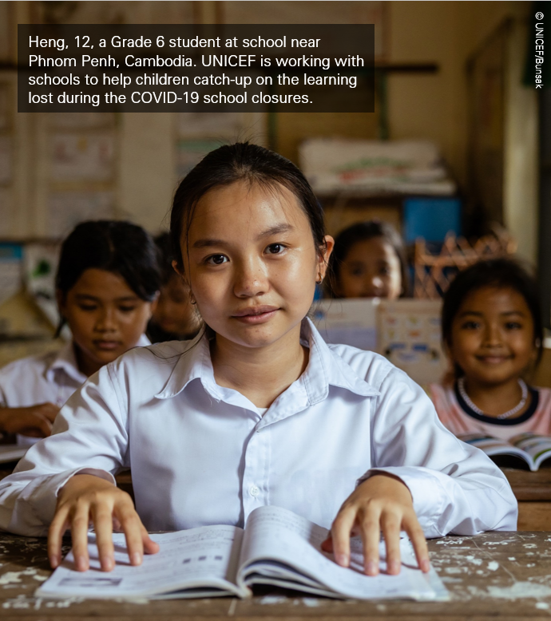
Who are UNICEF?
UNICEF is the world's leading children's organisation.
UNICEF is an agency of the United Nations – meaning that their work is impartial and non-political
They work to improve the rights of children providing humanitarian and developmental aid to children worldwide, particularly the most vulnerable.
Notes:
UNICEF is the world's leading children's organisation.
Why? Because UNICEF works in the world’s toughest places to reach the most vulnerable children, protecting the rights of every child, everywhere. To do that, they work in more than 190 countries worldwide.
UNICEF is an agency of the United Nations, meaning that the work UNICEF does is impartial and non-political. So, regardless of the nationality, race or religion, UNICEF works to ensure the rights of all children everywhere.
UNICEF is mandated to advance the rights of children. This is set out in the UN Conventions of the Rights of the Child – which we will come onto in the next slide. To advance the rights of children, UNICEF works with all the various United Nations agencies and funds to make sure that children are on the global agenda, especially the most vulnerable.

Slide 3




SOCCER AID FOR UNICEF 2024
vs
Sunday 9 June
Stamford Bridge
ITV1 and STV
Kick-off 7:30pm
Notes:
Soccer Aid is a football match that raises money for UNICEF. It is played between England and the World XI (eleven). The teams are made up of some of the football’s biggest legends like Eden Hazard and Jermain Defoe and celebrities from across the world like Usain Bolt, Miniminter and Maisie Adams.
And it’s the only FA-sanctioned mixed gender match!
This year’s Soccer Aid match is being held at Stamford Bridge - Chelsea’s stadium in London
It’s on Sunday 9th June and it kicks off at 7:30pm, and will be live on TV on ITV1 and STV.

Slide 4
ENGLAND
PLAYERS
JILL SCOTT (c)
STUART BROAD
BOBBY BRAZIER
SAM THOMPSON
PADDY McGUINNESS
DAVID JAMES
JERMAIN DEFOE
KAREN CARNEY
GARY CAHILL
TOM GRENNAN
JACK WILSHERE
JOE COLE
SIR MO FARAH
ALEX BROOKER
ERIN DOHERTY
STEVEN BARTLETT
DANNY DYER
THEO WALCOTT
ELLEN WHITE
MINIMINTER
MANAGEMENT & COACHES
FRANK LAMPARD
ROBBIE WILLIAMS
HARRY REDKNAPP
DAVID SEAMAN
SOCCER AID SKILLS COACH
BILLY WINGROVE
SOCCER AID WORLD XI
PLAYERS
USAIN BOLT (c)
EDEN HAZARD
TOMMY FURY
MAISIE ADAM
DIAMOND
ROBERTO CARLOS
MARTIN COMPSTON
ROMAN KEMP
JOHN OBI MIKEL
LEE MACK
THEO BAKER
KAYLYN KYLE
JASON MANFORD
MANAGEMENT & COACHES
MAURICIO POCHETTINO
JESUS PEREZ
SOCCER AID SKILLS COACH
BILLY WINGROVE
+ MORE NAMES TO BE ANNOUNCED!
Notes:
Here’s the line-up so far – can you spot any names?
● Jill Scott, Roberto Carlos, Theo Walcott, Frank Lampard and the one I’m most excited for - Eden Hazard
● And well-loved celebs like Usain Bolt, Sam Thompson, Mo Farah, Tom Grennan and Tommy Fury
More names are still being announced!

Slide 5
WE WANT TO MAKE SOCCER AID FOR UNICEF 2024 OUR BEST YEAR YET…
2024
?
2023
£14.6m
2022
£15.6m
2021
£13m
2020
£9.3m
2019
£7.9m
BUT WE NEED YOUR HELP to make £100million!
Notes:
Soccer Aid is an incredible way to bring people together to raise money for the important work that UNICEF does.
Since the first Soccer Aid in 2006, over £90m has been raised for UNICEF to support their work all over the world, and this year, they’re hoping to make it their biggest year yet and make over £100m!
To be able to do that, Soccer Aid for UNICEF rely on the generosity of the public to help raise money to allow them to deliver on this mission.

Slide 6
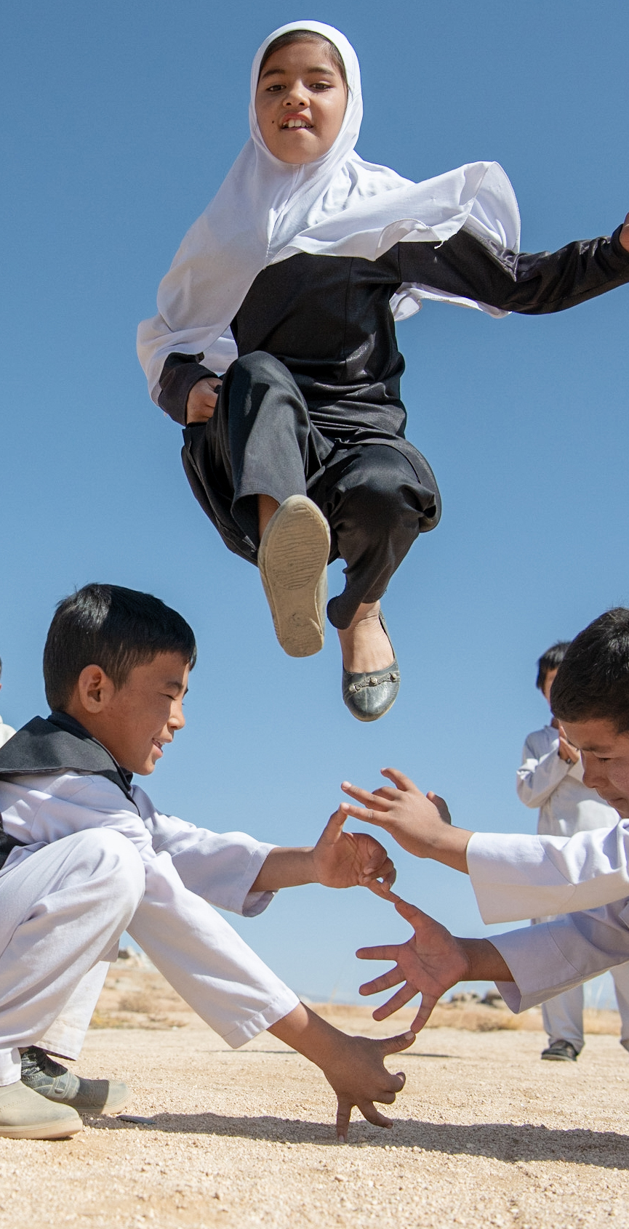




£2
could buy a bed net to protect a family from malaria
EVERY
POUND
YOU
RAISE
MAKES
A
DIFFERENCE
£5
could provide enough tablets to purify 600 litres of water
£10
could provide 60 children with a single dose of polio vaccine
£20
could buy thermal blankets to keep 4 babies warm in an emergency
Notes:
And every pound you raise make a huge difference. The money you help raise go directly towards UNICEF’s work for children all over the world, and as little as £1 can have a huge impact:

Slide 7


Every donation will be doubled – up to £4 million – thanks to
Notes:
And even better, this year we’re really excited to say the impact of the money you raise will be doubled.
Soccer Aid for UNICEF are really lucky to have a matched funding partner this year, the Children’s Investment Fund Foundation, who have pledged to match all donations raised up to £4m
That means every pound you raise will be doubled!

Slide 8

WHAT IS THE SOCCER
AID FOR UNICEF ACADEMY?
OUR SCHOOL IS SIGNED UP!
Challenge videos introduced by Soccer Aid celebrities!
Complete the challenges and raise money
We will do the challenges on XXXXXX week/day
Notes:
So what is the Academy?
This is where schools up and down the country take part and raise money for Soccer Aid for UNICEF. And we’re on the team!
We will be emailed videos that are introduced by celebrities that will set challenges like relays, quizzes and goal scoring!
As we take part in the challenges Soccer Aid have asked us to raise money by XXXXXXXX Whatever wording you’d like to use around fundraising - (sending letters to parents/ parents coming to watch/ bring in £2)
The videos will be sent to us by Soccer Aid on Monday 3 June – which is Soccer Aid week! We will complete the challenges ever day/ on XXX date

Slide 9

Play video - https://www.youtube.com/watch?v=ZvKfIyBbfUU
The Soccer Aid for UNICEF Acadmy helps to protect play for every child.
Notes:
Soccer Aid’s motto is PLAY FOR EVERY CHILD….. Ask children- Why is play so important?
Play is the foundation on which childhood is built. It’s so important for us as people when we’re children that we’re able to play because it helps us grow and develop mentally, physically, socially and emotionally.
Just take a listen to the video and the importance they place on play!
PLAY VIDEO
So you can see it’s so important. For millions of children around the world, their circumstances mean they can’t play properly,
By taking part in the Soccer Aid for UNICEF Academy we’re helping to protect play for every child so that can grow up happy, healthy, and ready to take on the world.

Slide 10
Our school plans:
Notes:
Add in any other information about your schools specific plans:

