Slide 1
SOCCER AID ACADEMY
Early Years
Notes:
Use this PowerPoint to introduce the learning activities in the two lessons of the UNICEF Soccer Aid Academy.
The notes are editable so they can be adapted to meet the needs of your pupils.

Slide 2

CHILD RIGHTS
Notes:
Introducing Child Rights:
If your pupils are not yet familiar with, or need a refresher on what child rights are, use the video in this slide to introduce the idea of child rights and the UN Convention on the Rights of the Child (UNCRC).
Explain:
The UNCRC (United Nations Convention on the Rights of the Child) is an important agreement [or treaty] made by nearly all of the countries in the world, who together have promised to protect children’s rights. The Convention explains who children are [everyone up to age of 18], all their rights, and the responsibilities of governments. All the rights are connected, they are all equally important and they cannot be taken away from children.
There are 54 Articles in the Convention. Each article is a statement that tells what these rights are. Articles 1-ZZZ explain the rights, and articles explain how governments and adults should work together to make sure all children are able to have these rights.
Everything that UNICEF does is to support the rights of children, to help make sure that children know what their rights and to help influence governments so they do their job to protect children.

Slide 3
Lesson 1:
PLAY FOR EVERY CHILD

Slide 4
MEET ALEX & ELAN
Play video - https://www.youtube.com/watch?v=5OLl1QMPjmU
Notes:
Meet Alex Booker & Elan
Introduce Alex Booker/Zaatari refugee camp video using information from the Soccer Aid leaflet.
Watch 3-minute video
Video Introduction:
I’m going to show you a short film about Soccer Aid player Alex Booker and a trip that he took to a Syrian refugee camp called Za’atari. During his trip, he is going to meet a girl named Elan who shares a similar disability to Alex. While you watch the film, I want you to think about the Rights of the Child, and which rights you think might be hardest for Elan to access?
You should be able to stream the film directly from this presentation by clicking on the play button. Please make sure that external content is enabled. If you experience problems, you can download the film (or stream it) at socceraid.org.uk/schools-resources or directly at https://www.youtube.com/watch?v=nDM_M65sPzs
After watching the film, discuss some of the issues raised. You can use the questions on the following slide as prompts.

Slide 5
PLAY FOR EVERY CHILD
Where did Alex go?
Who did he meet?
How did UNICEF support Elan with her disability?
What lessons did you learn from Elan?
What did you notice about the playground and sports equipment in the video? How was it created to help make sure every child could join in the play?
Which rights do you think might be hardest for Elan to access?
Notes:
Discussion
Where did Alex go?
[Za’Atari refugee camp in Jordan]
Who did he meet?
[Alex met Elan, and other Syrian children living in the camp]
How did UNICEF support Elan with her disability?
[Fitting her with a new prosthetic hand that was being 3-D printed in the camp]
What lessons did you learn from Elan?
What did you notice about the playground and sports equipment in the video?
[It was all created so that all children, including the children like Elan who have a disability, can use the equipment to play.]
How was it created to help make sure every child could join in the play?
[The equipment was designed so it works for everyone. For example, the seesaw is large, so children in wheelchairs can play on it]
Which rights do you think might be hardest for Elan to access?
Article 22. Children who move from their home country to another country as refugees (because it was not safe for them to stay there) should get help and protection and have the same rights as children born in that country.Article 24. Children have the right to the best health care possible, safe water to drink, nutritious food, a clean and safe environment, and information to help them stay well.
Article 27. Children have the right to food, clothing and a safe place to live, and to have their basic physical and mental needs met. Governments should help families and children who cannot afford this.
Article 31. Every child has the right to rest, relax, play and to take part in cultural and creative activities.
Once pupils have identified rights that are difficult for the Elan and the children in Za’atari camp to access, move on to the next slide, which provides a rights recap.
Additional discussion questions for adaptation:
What did you learn about in the video?
Who else supports UNICEF at Za’atar refugee camp implement the programs to help children with disabilities?
What did you learn about Za’atari refugee camp and the people who live there?
Why did Alex visit Za’atar refugee camp?
What did you learn about UNICEF’s work in helping children who are disabled?

Slide 6
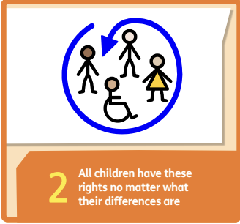
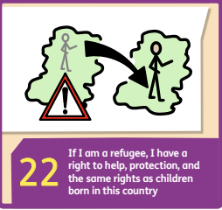
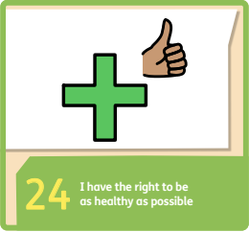
Play for Every Child
What do these rights mean to you?
Notes:
Review Articles 2, 22 and 24from the CRC using the short child-friendly CRC version of articles, and discuss:
What do these rights mean to you?
Why is it important that every child around the world has access to these rights?

Slide 7
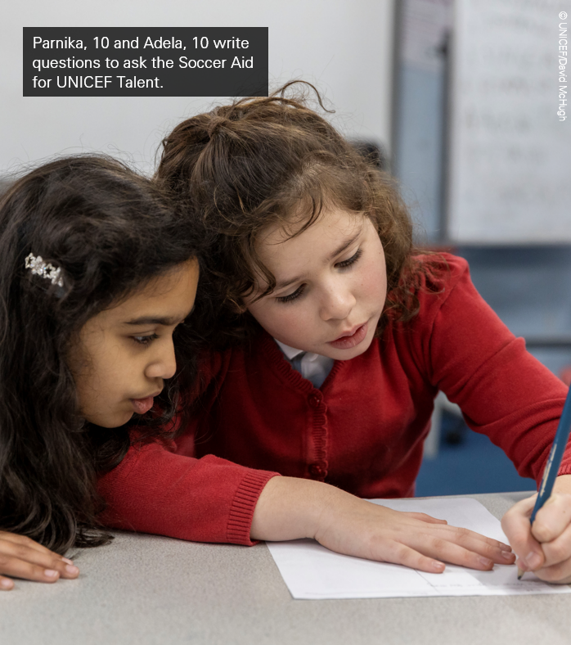
INCLUSION MEANS
EVERY CHILD CAN PLAY!
Play the ‘Human Mobile Phone’ game two ways
Pass the message by whispering
Pass the message without speaking
Notes:
Explain that in the activity we are going to think about inclusion - that every child has the right to play. This includes all children, no matter where they come from, and no matter what abilities they have. To be inclusive, we should focus on what every child can do, rather than thinking about what a child cannot do.
Ask: Has anyone in the group ever played the ”Human Mobile Phone” game? (versions of this game are sometimes called whisper down the lane, broken telephone, operator, grapevine, pass the message or telestrations)
[Note: if there are pupils in your class who have vision or hearing disability, you could skip the two comparative activities and complete this activity by playing only one version of the game that allows the children to communicate in any way they are able.]
Explain that there are different ways to play this game, and that as a group, we are going to try to play it two different ways:
Give the instructions for the first round of play: Invite all the children to sit in a circle. Explain: I’ll whisper a word (or phrase) into the ear of the first person, and that person will whisper what they heard into the ear of the next person, until the message has made its way all the way around the circle. The last person will then say aloud what the message is that they heard. At the end, we’ll see how close the final message is to the original message.
After completing the game, invite children to share how they liked playing the game. Was it easy to play or hard to play? What if you could not hear – would this game be easy to play or hard to play? What ability could a child who does not hear use to play the game? [eg, they could see, or sign, or draw]
Invite the children to take a second turn at the game, changing the rules to pass the message without speaking so it would be inclusive for all children and allow children who had a hearing disability their right to play.

Slide 8
GETTING HELP
If you have any concerns about anything we have covered in the session, please reach out:
INSERT FACILITATOR OR TEACHER NAME AND HOW TO CONTACT
INSERT SCHOOL DESIGNATED SAFEGUARDINGN LEAD
INSERT OTHER LOCAL REFERRAL SERVICE
youngminds.org.uk
nspcc.org.uk
Notes:
Complete the lesson by showing children this video that explains the importance of mental health in protecting play. You can watch the video from the presentation or directly at….

Slide 9
Lesson 2:
PLAY and WELLBEING
Notes:
Teacher Preparation:
Review and adapt discussion questions, review and adapt the Syrian game ‘hajlah’ for your class, preview the closing play and mental health video.

Slide 10
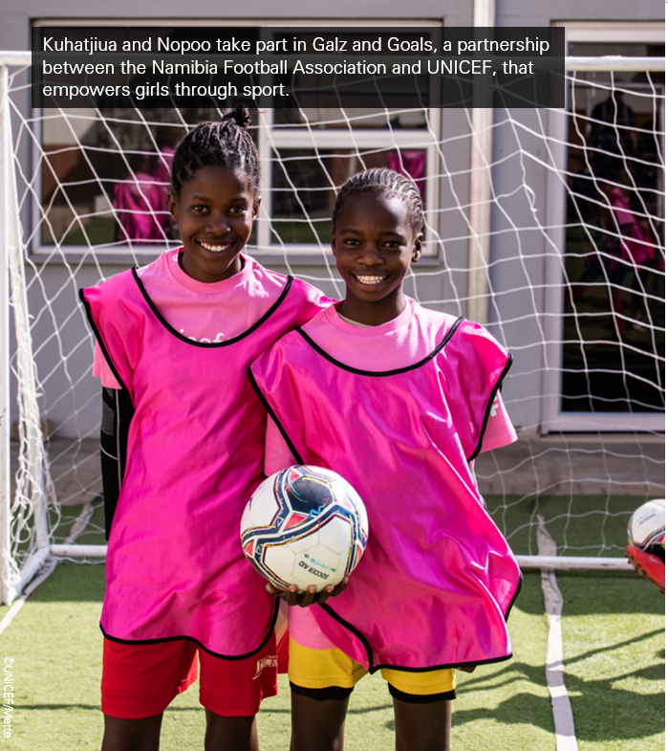
Every child has the right to play!
Notes:
Building on the activity from the Soccer Aid Academy Lesson 1, introduce that it’s not only important for all children to play because it is their right to play. It’s also important to play because play is good for our health and our growth as children – especially our mental health.
Use the questions on the following slide as prompts to begin a conversation about play and mental health.

Slide 11
PLAY AND WELLBEING
What games do you play?
Do you invent any games? What kind?
How does play make you feel? When you’re doing it? After you’ve done it?
How does play help you when you’re having a hard time?
Why do you think that play is important to your health — especially your mental health and wellbeing?

Slide 12
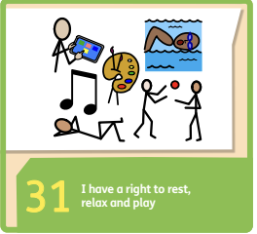
PLAY AND WELLBEING
What does this right mean to you?
Why is it important that every child around the world has access to play?
Notes:
Review Article 31 from the CRC using the short child-friendly CRC version of articles, and discuss:
What does this right mean to you?
Why is it important that every child around the world has access to this right to play?
Why is it important for children like these who are living in the Za’atari refugee camp to play? (or children who are living through wars and natural disasters in other places around the world)

Slide 13
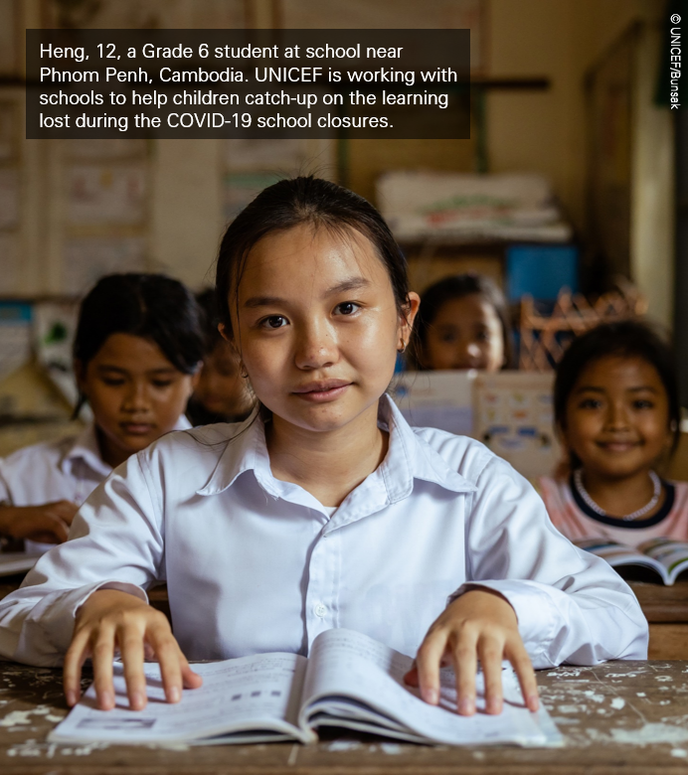
Children Everywhere have the Right to Play
What is your favourite game to play?
Learn a new game that children in a different part of the world play
Notes:
Learning Activity – Right to Play and Mental Health
Invite each child to think about and share what their favorite game to play is. Ask: Why is it your favorite? How do you feel when you play the game? How do you feel after you play the game?
Invite the children to share individually or in groups and lead them to understanding how play is not just fun, but important for how it makes them feel and for keeping their bodies and minds healthy. This why it is so important that all children everywhere have their right to play.
Explain to children that they are going to learn a new game called “hajla” that many Syrian children like Elan play. This game is similar to the game we know called hopscotch.
To play the game, you draw a grid of eight squares on the ground using chalk (or you could play it indoors using painter’s tape to create the lines).
There are many ways you can play the game. You can share the different ways or choose to play the game one way that is appropriate for the age and ability of all the children in your class.
You can number the squares and take turns kicking a stone into the grid. You get points based on the number of the square where your stone stops – but you lose your points if your stone lands on a line or outside the grid.
Like hopscotch, you can hop through the grid on one foot, number to number. Some children play by tossing the stone into a numbered square and skip that square while hopping. Other children will play by kicking the stone from square to square as they hop - losing their turn if the stone lands on a line of the grid or outside of the squares.
Other adaptations to play hajla so to include all children in playing the game might include:
-Creating the squares to be much larger so a child in a wheelchair could move through the squares and push the stone along with a stick.
- Instead of kicking the stone into the grid, children take turns tossing the stone into the grid for points (losing points if the stone lands on a line or outside the grid). Children could also toss bean bags or another object that is softer and larger than a stone.
- Children working in pairs to help one another hop through the grid. This adaptation could be appropriate for children who may have challenges with vision or mobility.
How did you feel playing this game? Why do you think it is important for children in a place like the Za’atari refugee camp to be able to keep playing their favourite games?

Slide 14
PLAY and WELLBEING
Play video - https://www.youtube.com/watch?v=ZvKfIyBbfUU
Notes:
Complete the lesson by showing children this video that explains the importance of mental health in protecting play. You can watch the video from the presentation or directly at….

Slide 15
GETTING HELP
If you have any concerns about anything we have covered in the session, please reach out:
INSERT FACILITATOR OR TEACHER NAME AND HOW TO CONTACT
INSERT SCHOOL DESIGNATED SAFEGUARDINGN LEAD
INSERT OTHER LOCAL REFERRAL SERVICE
youngminds.org.uk
nspcc.org.uk
Notes:
Complete the lesson by showing children this video that explains the importance of mental health in protecting play. You can watch the video from the presentation or directly at….

