Slide 1
SOCCER AID ACADEMY
Secondary
Notes:
Use this PowerPoint to introduce the learning activities in the two lessons of the UNICEF Soccer Aid Academy.
The notes are editable so they can be adapted to meet the needs of your pupils.

Slide 2

CHILD RIGHTS
Notes:
Introducing Child Rights:
If your pupils are not yet familiar with, or need a refresher on what child rights are, use the YouTube video (at https://www.youtube.com/watch?v=TFMqTDIYI2U) to introduce the idea of child rights and the UN Convention on the Rights of the Child (UNCRC).
Explain:
The UNCRC (United Nations Convention on the Rights of the Child) is an important agreement [or treaty] made by the UK Government and the governments of nearly all of the countries in the world, who together have promised to protect children’s rights. The Convention explains who children are [everyone up to age of 18], all their rights, and the responsibilities of governments to protect the rights of children.
The first 42 articles set out the rights that are for all children, the rights-holders, no matter their ethnicity, gender, religion, language, abilities, or any other status. Articles 43-54 describe how adults and governments must work together as duty-bearers to fulfill their obligation to make sure that children’s rights are put into practice.
There are 54 Articles in the Convention. Each article is a statement that tells what these rights are. Articles 1-42 explain the rights, and articles 43-54 explain how governments (as duty-bearers) should do what they’ve agreed to, and make sure all children are able to have these rights. All the rights are connected, they are all equally important and they cannot be taken away from children.
Everything that UNICEF does is to support the rights of children, to help make sure that children know what their rights and to help influence governments so they do their job to protect children.

Slide 3
Lesson 1:
PLAY FOR EVERY CHILD

Slide 4
MEET ALEX & ELAN
Play video - https://www.youtube.com/watch?v=5OLl1QMPjmU
Notes:
Meet Alex Booker & Elan
Introduce Alex Booker/Zaatari refugee camp video using information from the Soccer Aid leaflet.
Watch 3-minute video
I’m going to show you a short film about Soccer Aid player Alex Booker and a trip that he took to a Syrian refugee camp called Za’atari. During his trip, he is going to meet a girl named Elan who shares a similar disability to Alex. While you watch the film I want you to think about the Rights of the Child, and which rights you think might be hardest for Elan to access?
You should be able to stream the film directly from this presentation by clicking on the play button. Please make sure that external content is enabled. If you experience problems, you can download the film (or stream it) at socceraid.org.uk/schools-resources (https://www.youtube.com/watch?v=nDM_M65sPzs)
After watching the film, discuss some of the issues raised. You can use the questions on the following slide as prompts.

Slide 5
DISABILITY AND THE RIGHTS OF CHILDREN
What did you learn about in the video?
Where did Alex go? What did you learn about Za’atari refugee camp and the people who live there?
How did UNICEF support Elan with her disability?
What did you notice about the playground and sports equipment in the video? How was it created to help make sure every child could join in the play?
What did you learn about UNICEF’s work in helping children who are disabled?
Which rights do you think might be hardest for Elan and children in Za’atari camp to access?
Notes:
Discussion
What did you learn about in the video?
[Syrian children in Za’Atari refugee camp in Jordan, children’s right to play, a child getting a prosthetic hand]
Where did Alex go? What did you learn about Za’atari refguee camp and the people who live there.
[Alex went to Za’Atari refugee camp in Jordan. He met Elan and other Syrian children living in the camp. Za’atari camp is in Jordan and its one of the largest camps in the world. The people who live there come from Syria, but many of the young people like Elan were born in the camp and have only ever lived there]
How did UNICEF support Elan with her disability?
[Fitting her with a new prosthetic hand that was being 3-D printed in the camp]
What did you notice about the playground and sports equipment in the video?
[It was all created so that all children, including the children like Elan who have a disability, can use the equipment to play.]
How was it created to help make sure every child could join in the play?
[The equipment was designed so it works for everyone. For example, the seesaw is large, so children in wheelchairs can play on it]
What did you learn about UNICEF’s work in helping children who are disabled?
Which rights do you think might be hardest for Elan and other children in Za’atari camp to access?
Article 22. Children who move from their home country to another country as refugees (because it was not safe for them to stay there) should get help and protection and have the same rights as children born in that country.Article 24. Children have the right to the best health care possible, safe water to drink, nutritious food, a clean and safe environment, and information to help them stay well.
Article 27. Children have the right to food, clothing and a safe place to live, and to have their basic physical and mental needs met. Governments should help families and children who cannot afford this.
Article 31. Every child has the right to rest, relax, play and to take part in cultural and creative activities.
Once pupils have identified rights that are difficult for the Elan and the children in Za’atari camp to access, move on to the next slide, which provides a rights recap.
Additional discussion questions for adaptation:
Why did Alex visit Za’atar refugee camp?
What experiences did Alex and Elan share about their disabilities?
What did you learn from Elan?
Who else supports UNICEF at Za’atar refugee camp to implement the programs to help children with disabilities?

Slide 6



Play for Every Child
Article 22: Refugee Children
Children who move from their home country to another country as refugees (because it was not safe for them to stay there) should get help and protection and have the same rights as children born in that country.
Article 2: No Discrimination
All children have all these rights, no matter who they are, where they live, what
language they speak, what their religion is, what they think, what they look like, if they are a boy or girl, if they have a disability, if they are rich or poor,
and no matter who their parents or families are or what their parents or families believe or
do. No child should be treated unfairly
for any reason.
Article 24: Health,
Water, Food,Environment
Children have the right to the best health care possible, clean water to drink, healthy food and a clean and safe environment to live in. All adults and children should have information about how to stay safe and healthy.
What do these
rights mean to you?
Notes:
Review Articles 2, 22 and 24 from the CRC using the short child-friendly CRC version of articles, and discuss:
What do these rights mean to you?
Why is it important that every child around the world has access to these rights?

Slide 7
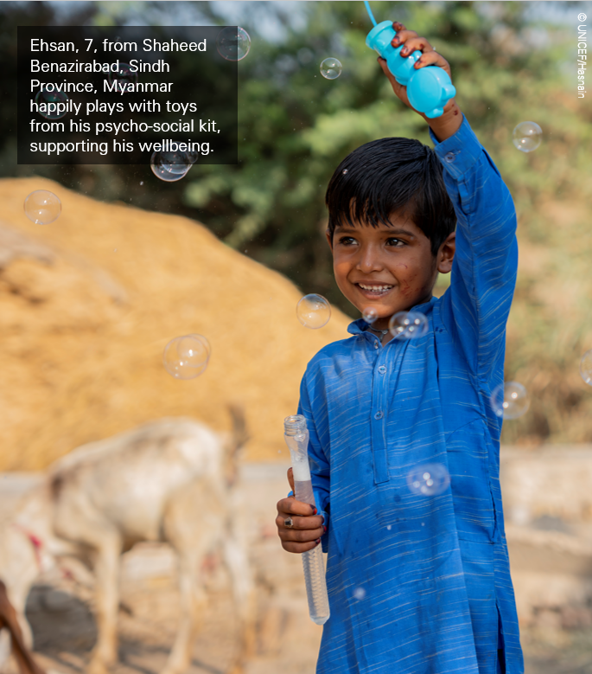
Inclusion is focusing on what everyone CAN do, not focusing on what someone cannot do
Design your own inclusive game
Create simple instructions that everyone can understand
Play in teams or in pairs
Make the space safe for everyone
Think about how you can adapt the game to help children with different abilities join in
  Sitting / standing /moving around
  Speaking / signing / reading
Notes:
Explain to pupils that a key principle to inclusion is focusing on what everyone CAN do, not focusing on what a child/children cannot do.
Invite young people to work in small groups to create their own game to play in class.
(As an alternative, young people could design an inclusive play area - using paper and coloured markers to draw it, or clay, art materials, or a computer programme like Minecraft of Sketchup to create a 3d model.)
Review the bullet points to give young people tips on creating inclusive play.
Some prompts to help young people get started may include:
An outdoor game or an indoor game (choose one to give direction)
A game that can be played in 10 minutes
A game that is played sitting down
A game that only uses items you can find in the room
Give young people 30 minutes to create their game idea, then invite each group to present their game to the group. In addition to sharing the rules and goals of their game, ask young people to share how they used the principle to make it inclusive.
If time permits, you could play the created games, vote on the class favourites to try, or encourage young people to play them during a break time.
*Note: For more details on creating inclusive activites, review the full Unicef resource:
https://www.unicef.org/supply/media/18556/file/disability-guidance-recreational-activities-UNICEF-education-kit-handbook.pdf

Slide 8
GETTING HELP
If you have any concerns about anything we have covered in the session, please reach out:
INSERT FACILITATOR OR TEACHER NAME AND HOW TO CONTACT
INSERT SCHOOL DESIGNATED SAFEGUARDINGN LEAD
INSERT OTHER LOCAL REFERRAL SERVICE
youngminds.org.uk
nspcc.org.uk
Notes:
Complete the lesson by showing children this video that explains the importance of mental health in protecting play. You can watch the video from the presentation or directly at….

Slide 9
Lesson 2:
PLAY and
MENTAL HEALTH
Notes:
Teacher Preparation:
Review and adapt discussion questions, review and adapt the play timeline activity for your class, preview the closing play and mental health video.

Slide 10
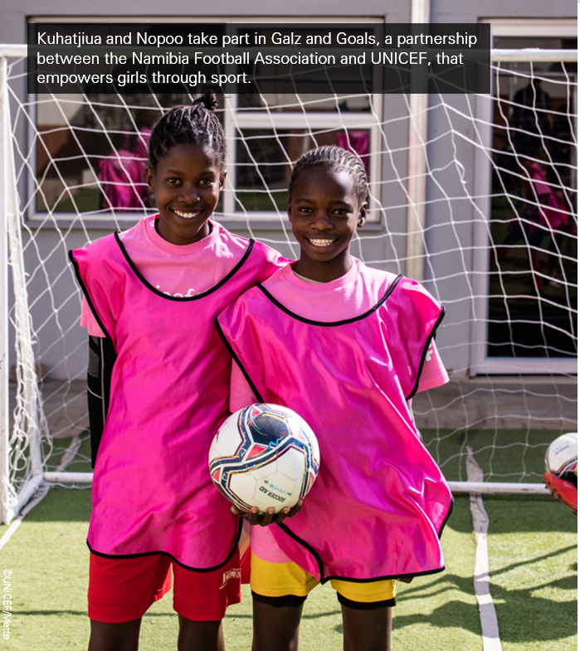
Every child has the right to play!
Notes:
Building on the activity from the Soccer Aid Academy Lesson 1, introduce that it’s not only important for all children to play because it is their right to play. It’s also important to play because play is good for our health and our growth as children – especially our mental health.
Use the questions on the following slide as prompts to begin a conversation about play and mental health.

Slide 11
PLAY AND MENTAL HEALTH
What games do you like to play?
How does play support your mental health?
In what ways does play help you when you’re having a hard time?
Think back to the Covid pandemic– can you think of a way that play was helpful/important to help you cope during this time?
What did you learn about the stigmas both Alex and Elan have faced with their disability and how important it is to protect their mental health?
Why is play an important right for all children?

Slide 12

Play for Every Child
What does this right mean to you?
Why is it important that every child around the world has access to play?
Article 31:
Rest, Play, Culture, Arts
Every child has the right to rest, relax, play and to take part in cultural and creative activities.
Notes:
Review Article 31 from the CRC using the short child-friendly CRC version of articles, and discuss:
What does this right mean to you?
Why is it important that every child around the world has access to this right to play?
Why is it important for children like these who are living in the Za’atari refugee camp to play? (or children who are living through wars and natural disasters in other places around the world)

Slide 13
Play for Mental Health At Every Age: TIMELINE
What was your favourite game as a young child?
What play did you enjoy doing in early years? In primary?
What is your favorite game now?
How has play changed as you’ve gotten older?
How did play at each of these times make you feel or help you ?
Create a timeline that shows 3-5 periods of development in your life (an age, school year or challenge), a favorite way to play during this period, and how this play helped you or made you feel.
Notes:
Invite young people to work in pairs of small groups to complete the Play and Mental Health at Every Age Timeline Activity.
Take a few minutes in quiet and think about the idea of play throughout your lifetime. What was your favorite game as a young child, or what did you enjoy doing for fun and play in early years and in primary? Do you remember how this game or activity made you feel or how it helped you or what values it taught you as you grew up that are still important to you now? (You can ask a parent, grandparent or caretaker with whom you grew up to help you think of examples if you cannot remember.) Think about how play has changed as you’ve got older. What is your favorite way to ‘play’ now.
Using A4 paper and arts materials, create a timeline that includes 3-5 periods of development or big events in your life. On the timeline mark the dates or eras of your life. Then on one side of the timeline, write or draw the play activity or game that was memorable from this period. On the opposite side of the timeline, write down or draw how you felt about this activity, or how it helped you during that specific time in your life. (Note – events could be highlight a specific age or school year, or life challenge such as the Covid pandemic).
After completing and decorating their timeline, invite pupils to share their timeline and learning within their small group or volunteer to share their timeline with the larger class. After the pupils have shared, consider if there are any common observations. What were some of the ways that exercising the right to play helped them overcome a challenge or stay mentally healthy?
If any of the play/activities shared are not common to the group, invite the pupil to share about the game or teach the class how to play it if time permits.

Slide 14
PLAY & MENTAL HEALTH
Play video - https://www.youtube.com/watch?v=ZvKfIyBbfUU
Notes:
Complete the lesson by showing children this video that explains the importance of mental health in protecting play. You can watch the video from the presentation or directly at….

Slide 15
GETTING HELP
If you have any concerns about anything we have covered in the session, please reach out:
INSERT FACILITATOR OR TEACHER NAME AND HOW TO CONTACT
INSERT SCHOOL DESIGNATED SAFEGUARDINGN LEAD
INSERT OTHER LOCAL REFERRAL SERVICE
youngminds.org.uk
nspcc.org.uk
Notes:
Complete the lesson by showing children this video that explains the importance of mental health in protecting play. You can watch the video from the presentation or directly at….

