Slide 1
SOCCER AID ACADEMY
Primary
Notes:
Use this PowerPoint to introduce the learning activities in the two lessons of the UNICEF Soccer Aid Academy.
The notes are editable so they can be adapted to meet the needs of your pupils.

Slide 2

CHILD RIGHTS
Notes:
Introducing Child Rights:
If your pupils are not yet familiar with, or need a refresher on what child rights are, use the video in this slide to introduce the idea of child rights and the UN Convention on the Rights of the Child (UNCRC).
Explain:
The UNCRC (United Nations Convention on the Rights of the Child) is an important agreement [or treaty] made by the UK Government and the governments of nearly all of the countries in the world, who together have promised to protect children’s rights. The Convention explains who children are [everyone up to age of 18], all their rights, and the responsibilities of governments. All the rights are connected, they are all equally important and they cannot be taken away from children.
The first 42 articles set out the rights that are for all children, the rights-holders, no matter their ethnicity, gender, religion, language, abilities, or any other status. Articles 43-54 describe how adults and governments must work together as duty-bearers to fulfill their obligation to make sure that children’s rights are put into practice.
There are 54 Articles in the Convention. Each article is a statement that tells what these rights are. Articles 1-42 explain the rights, and articles 43-54 explain how governments and adults should work together (as duty-bearers) to do what they’ve agreed to, and make sure all children are able to have these rights.
Everything that UNICEF does is to support the rights of children, to help make sure that children know what their rights and to help influence governments so they do their job to protect children.

Slide 3
Lesson 1:
PLAY FOR EVERY CHILD

Slide 4
MEET ALEX & ELAN
Play video - https://www.youtube.com/watch?v=5OLl1QMPjmU
Notes:
Meet Alex Booker & Elan
Introduce Alex Booker/Zaatari refugee camp video using information from the Soccer Aid leaflet.
Watch 3-minute video
Video Introduction:
I’m going to show you a short film about Soccer Aid player Alex Booker and a trip that he took to a Syrian refugee camp called Za’atari. During his trip, he is going to meet a girl named Elan who shares a similar disability to Alex. While you watch the film, I want you to think about the Rights of the Child, and which rights you think might be hardest for Elan to access?
You should be able to stream the film directly from this presentation by clicking on the play button. Please make sure that external content is enabled. If you experience problems, you can download the film (or stream it) at socceraid.org.uk/schools-resources or directly at https://www.youtube.com/watch?v=nDM_M65sPzs
After watching the film, discuss some of the issues raised. You can use the questions on the following slide as prompts.

Slide 5
DISABILITY AND THE RIGHTS OF CHILDREN
What did you learn about in the video?
Where did Alex go? Who did he meet?
How did UNICEF support Elan with her disability?
What did you learn about Za’atari refugee camp and the people who live there?
What did you notice about the playground and sports equipment in the video? How was it created to help make sure every child could join in the play?
Which rights do you think might be hardest for Elan to access?
Notes:
Discussion
What did you learn about in the video?
[Syrian children in Za’Atari refugee camp in Jordan, children’s right to play, a child getting a prosthetic hand]
Where did Alex go? Who did he meet?
[Alex went to Za’Atari refugee camp in Jordan. He met Elan and other Syrian children living in the camp.]
How did UNICEF support Elan with her disability?
[Fitting her with a new prosthetic hand that was being 3-D printed in the camp]
What did you learn about Za’atari refguee camp and the people who live there?
[The refugee camp is in Jordan and its one of the largest camps in the world. The people who live there come from Syria, but many of the young people like Elan were born in the camp and have only ever lived there]
What did you notice about the playground and sports equipment in the video?
[It was all created so that all children, including the children like Elan who have a disability, can use the equipment to play.]
How was it created to help make sure every child could join in the play?
[The equipment was designed so it works for everyone. For example, the seesaw is large, so children in wheelchairs can play on it]
Which rights do you think might be hardest for Elan to access?
Article 22. Children who move from their home country to another country as refugees (because it was not safe for them to stay there) should get help and protection and have the same rights as children born in that country.Article 24. Children have the right to the best health care possible, safe water to drink, nutritious food, a clean and safe environment, and information to help them stay well.
Article 27. Children have the right to food, clothing and a safe place to live, and to have their basic physical and mental needs met. Governments should help families and children who cannot afford this.
Article 31. Every child has the right to rest, relax, play and to take part in cultural and creative activities.
Once pupils have identified rights that are difficult for the Elan and the children in Za’atari camp to access, move on to the next slide, which provides a rights recap.
Additional discussion questions for adaptation:
What did you learn from Elan
Who else supports UNICEF at Za’atar refugee camp implement the programs to help children with disabilities?
What did you learn about Za’atari refugee camp and the people who live there?
Why did Alex visit Za’atar refugee camp?
What did you learn about UNICEF’s work in helping children who are disabled?

Slide 6



Play for Every Child
Article 22: Refugee Children
Children who move from their home country to another country as refugees (because it was not safe for them to stay there) should get help and protection and have the same rights as children born in that country.
Article 2: No Discrimination
All children have all these rights, no matter who they are, where they live, what
language they speak, what their religion is, what they think, what they look like, if they are a boy or girl, if they have a disability, if they are rich or poor,
and no matter who their parents or families are or what their parents or families believe or
do. No child should be treated unfairly
for any reason.
Article 24: Health,
Water, Food,Environment
Children have the right to the best health care possible, clean water to drink, healthy food and a clean and safe environment to live in. All adults and children should have information about how to stay safe and healthy.
What do these
rights mean to you?
Notes:
Review Articles 2, 22 and 24 from the CRC using the short child-friendly CRC version of articles, and discuss:
What do these rights mean to you?
Why is it important that every child around the world has access to these rights?

Slide 7
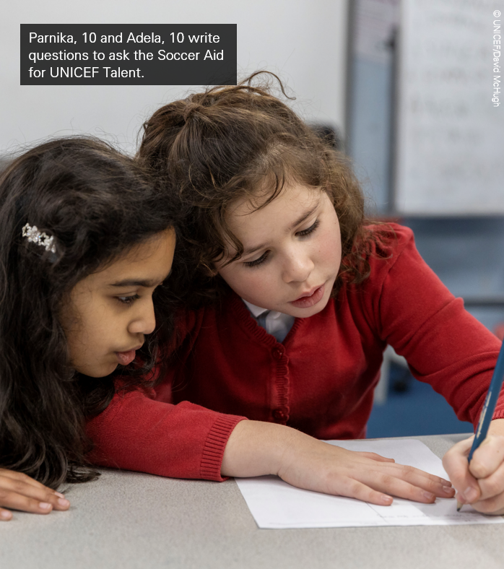
INCLUSION MEANS
EVERY CHILD CAN PLAY!
Play the ‘Human Mobile Phone’ game two ways
Pass the message by whispering
Pass the message without speaking
Notes:
Explain that in the activity we are going to think about inclusion - that every child has the right to play. This includes all children, no matter where they come from, and no matter what abilities they have. To be inclusive, we should focus on what every child can do, rather than thinking about what a child cannot do.
Ask: Has anyone in the group ever played the ”Human Mobile Phone” game? (versions of this game are sometimes called whisper down the lane, broken telephone, operator, grapevine, pass the message or telestrations)
[Note: if there are pupils in your class who have vision or hearing disability, you could skip the two comparative activities and complete this activity, by playing only the third version of the game which includes adaptations for both sight and hearing.]
Explain that there are different ways to play this game, and that as a group, we are going to play it two different ways:
The first time we’ll play it, we’ll all sit in a circle. I’ll whisper a word (or phrase) into the ear of the first person, and that person will whisper what they heard into the ear of the next person, until the message has made its way all the way around the circle. The last person will then say aloud what the message is that they heard. At the end, we’ll see how close the final message is to the original message.
The second time we’ll play the game, we’ll not whisper any words, but instead, we’ll use paper to take turns drawing the word (or signing the word) and guessing what the word is. The first person will start with the given word and draw a picture of it (or sign it to the next person). The next person will guess what the picture (or sign is) is and write the word for the next person – who will draw or sign it in turn until the word reaches the last person.
In the first version we played, we created a game that was inclusive of everyone who could hear. But what is someone in the class could not hear? The second version of the game showed us that we could play the same game in a different way, include everyone who could see and draw.
Is there a third way that you could play the game mixing the rules of the two games together so you could include other abilities that children might have, and make sure that all children were able to have their right to play? (ie. some children speak the word and some children act out the word)

Slide 8
GETTING HELP
If you have any concerns about anything we have covered in the session, please reach out:
INSERT FACILITATOR OR TEACHER NAME AND HOW TO CONTACT
INSERT SCHOOL DESIGNATED SAFEGUARDINGN LEAD
INSERT OTHER LOCAL REFERRAL SERVICE
youngminds.org.uk
nspcc.org.uk
Notes:
Complete the lesson by showing children this video that explains the importance of mental health in protecting play. You can watch the video from the presentation or directly at….

Slide 9
Lesson 2:
PLAY and WELLBEING
Notes:
Teacher Preparation:
Review and adapt discussion questions, review and adapt the Syrian game ‘hajlah’ for your class, preview the closing play and mental health video.

Slide 10
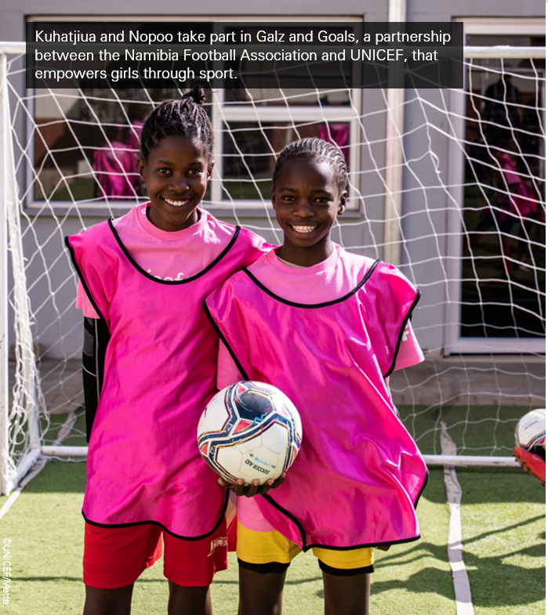
Every child has the right to play!
Notes:
Building on the activity from the Soccer Aid Academy Lesson 1, introduce that it’s not only important for all children to play because it is their right to play. It’s also important to play because play is good for our health and our growth as children – especially our mental health.
Use the questions on the following slide as prompts to begin a conversation about play and mental health.

Slide 11
PLAY AND WELLBEING
What games do you play?
Do you invent any games? What kind?
How does play make you feel? When you’re doing it? After you’ve done it?
How does play help you when you’re having a hard time?
Why do you think that play is important to your health — especially your mental health and wellbeing?
What does the right to play mean to you?

Slide 12

Play for Every Child
What does this right mean to you?
Why is it important that every child around the world has access to play?
Article 31:
Rest, Play, Culture, Arts
Every child has the right to rest, relax, play and to take part in cultural and creative activities.
Notes:
Review Article 31 from the CRC using the short child-friendly CRC version of articles, and discuss:
What does this right mean to you?
Why is it important that every child around the world has access to this right to play?
Why is it important for children like these who are living in the Za’atari refugee camp to play? (or children who are living through wars and natural disasters in other places around the world)

Slide 13
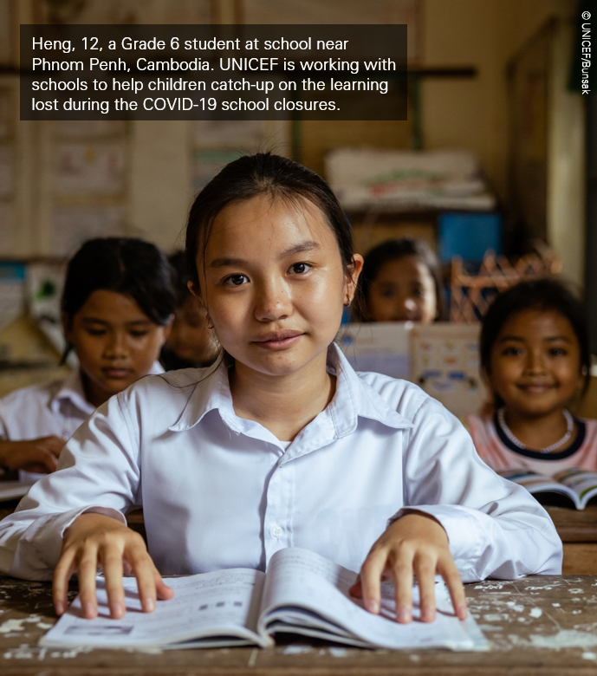
Play makes me feel ….
Draw a picture of yourself doing your favourite play activity.
Think about … “How do I feel when I get to play?’
Draw a thought cloud on your picture and write inside how you feel about doing your favorite play.
Notes:
Learning Activity
Draw a picture of yourself doing your favorite play activity on A4 paper (or poster paper) – this may be active play like running, jumping or playing sport, or it may be a less active game or play activity like puzzling or sewing or doing crafts. Create a thought/feeling bubble around your drawing and write inside the feelings/thoughts that you have about doing this activity and in what ways that it helps you.
Invite children to share their drawings. Conclude by discussing the question: “How do you think that a child’s right to play (Article 31) is linked to a child’s right to the best possible health (Article 24)?

Slide 14
PLAY and WELLBEING
Play video - https://www.youtube.com/watch?v=ZvKfIyBbfUU
Notes:
Complete the lesson by showing children this video that explains the importance of mental health in protecting play. You can watch the video from the presentation or directly at….

Slide 15
GETTING HELP
If you have any concerns about anything we have covered in the session, please reach out:
INSERT FACILITATOR OR TEACHER NAME AND HOW TO CONTACT
INSERT SCHOOL DESIGNATED SAFEGUARDINGN LEAD
INSERT OTHER LOCAL REFERRAL SERVICE
youngminds.org.uk
nspcc.org.uk
Notes:
Complete the lesson by showing children this video that explains the importance of mental health in protecting play. You can watch the video from the presentation or directly at….

